Slide 1
Ballistic Bowling
Strike a Pose—Wait, Strike the Pins!
Created by Jenil Jhala & Shreya Ghimire

Slide 2
Table of contents
01
02
03
04
05
Introduction
Reference
06
Features
Appendix
07
Development Process
Thankyou
Class Diagram

Slide 3
Introduction
Ballistic Bowling is not just a game but an experience crafted to challenge players’ skills while maintaining a sense of excitement and competition. This report covers the detailed aspects of the game, including its conceptualization, development process, features, and technical details.
This report presents Ballistic Bowling, an innovative and engaging bowling game developed to deliver a dynamic and enjoyable gaming experience. Designed with multiple levels of increasing difficulty, immersive sound effects, and visually captivating graphics, the game combines elements of precision, strategy, and fun.
Whether it's the interactive sound effects that bring the lanes to life or the challenge of achieving a perfect strike, Ballistic Bowling offers a comprehensive gaming experience. This document also provides insights into the game's design choices and references that helped shape its development, ensuring a complete overview of the project.

Slide 4
Levels of Fun
Features of Ballistic Bowling
Our game features multiple levels with increasing difficulty, keeping players engaged and challenged. Each level is uniquely designed to test both precision and strategy.
Dynamic Sound Effects
To make the gameplay immersive, we’ve added realistic bowling sounds. Strikes, spares, and even gutter balls come with interactive feedback to enhance the experience.

Slide 5
Ballistic Bowling offers high-quality graphics with detailed visuals of the bowling alley. The animations for rolling balls and falling pins are smooth and eye-catching.
Visual Appeal.
User-Friendly Interface
We’ve designed the interface to be intuitive and easy to navigate. From menus to gameplay instructions, everything is accessible for players of all ages.
Scoring System
The game features a real-time scoring system that accurately calculates points. Bonus points are awarded for perfect strikes and completing levels, making it rewarding for players.

Slide 6
Multilevel Gameplay
Players progress through levels with increasing complexity. Each level introduces new challenges and keeps the excitement alive as players aim for higher achievements.
Responsive Controls
With smooth keyboard and mouse integration, the controls are responsive and easy to use. The physics are realistic, making every ball roll and pin collision feel authentic.
Help and About Section
We’ve included a detailed “Know the Alley” page that provides insights into the game, along with a “Bowler’s Guide” to help players improve their skills.
Competitive Edge
Ballistic Bowling keeps track of high scores, encouraging players to challenge themselves and compete with friends. It’s perfect for solo gameplay or friendly competitions.

Slide 7
Development Process
Planning
We started by thinking about the idea for our game, "Ballistic Bowling." We decided on important features like hitting the pins, scoring points, having different levels, and making the game fun and easy to play.
Design
We planned how the game would work. We decided on parts like the ball, pins, score screen, and menu. This helped us organize everything before starting to code.
Implementation
We created the game using MonoGame. We added features like moving the ball, knocking down pins, showing scores, and adding fun sound effects. We also made sure each level had new challenges.

Slide 8
Testing
We played the game many times to make sure everything worked well. We checked if the ball hit the pins correctly if the score was right, and if the controls were smooth.
Finalization
After testing, we made the game look better by improving the menu, adding nice backgrounds, and making sure it was fast and smooth. Finally, we got the game ready for others to play.

Slide 9
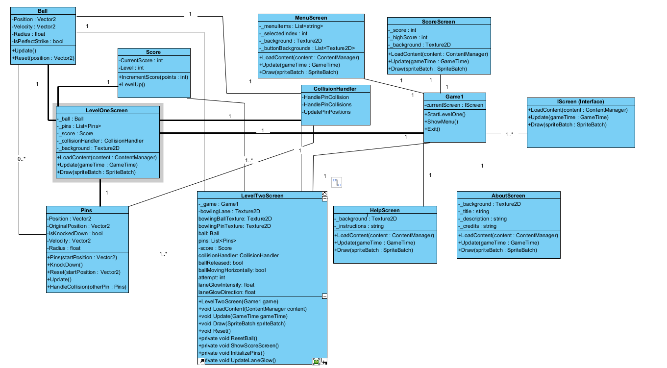
Class Diagram

Slide 10
Game1:
Main controller managing screens and gameplay.
IScreen Interface:
Standardizes methods (LoadContent, Update, Draw) for all screens.
Handles menu navigation and transitions.
MenuScreen:
Manage gameplay for Level 1 and Level 2 using Ball, Pins, CollisionHandler and Score.
Levels Screen:
ScoreScreen:
Displays current and high scores after gameplay.
HelpScreen & AboutScreen:
Provide game controls and details.
Ball & Pins:
Handles the main gameplay, where the ball is rolled to knock down the pins.
CollisionHandler:
Manages Ball and Pins Collision.
Score:
Tracks player score and level progression.

Slide 11
Reference
MonoGame Framework: https://www.monogame.net
Visual Studio IDE: https://visualstudio.microsoft.com
Visual Paradigm: https://www.visual-paradigm.com
Freesound: https://freesound.org/
Vecteezy: https://www.vecteezy.com/

Slide 12
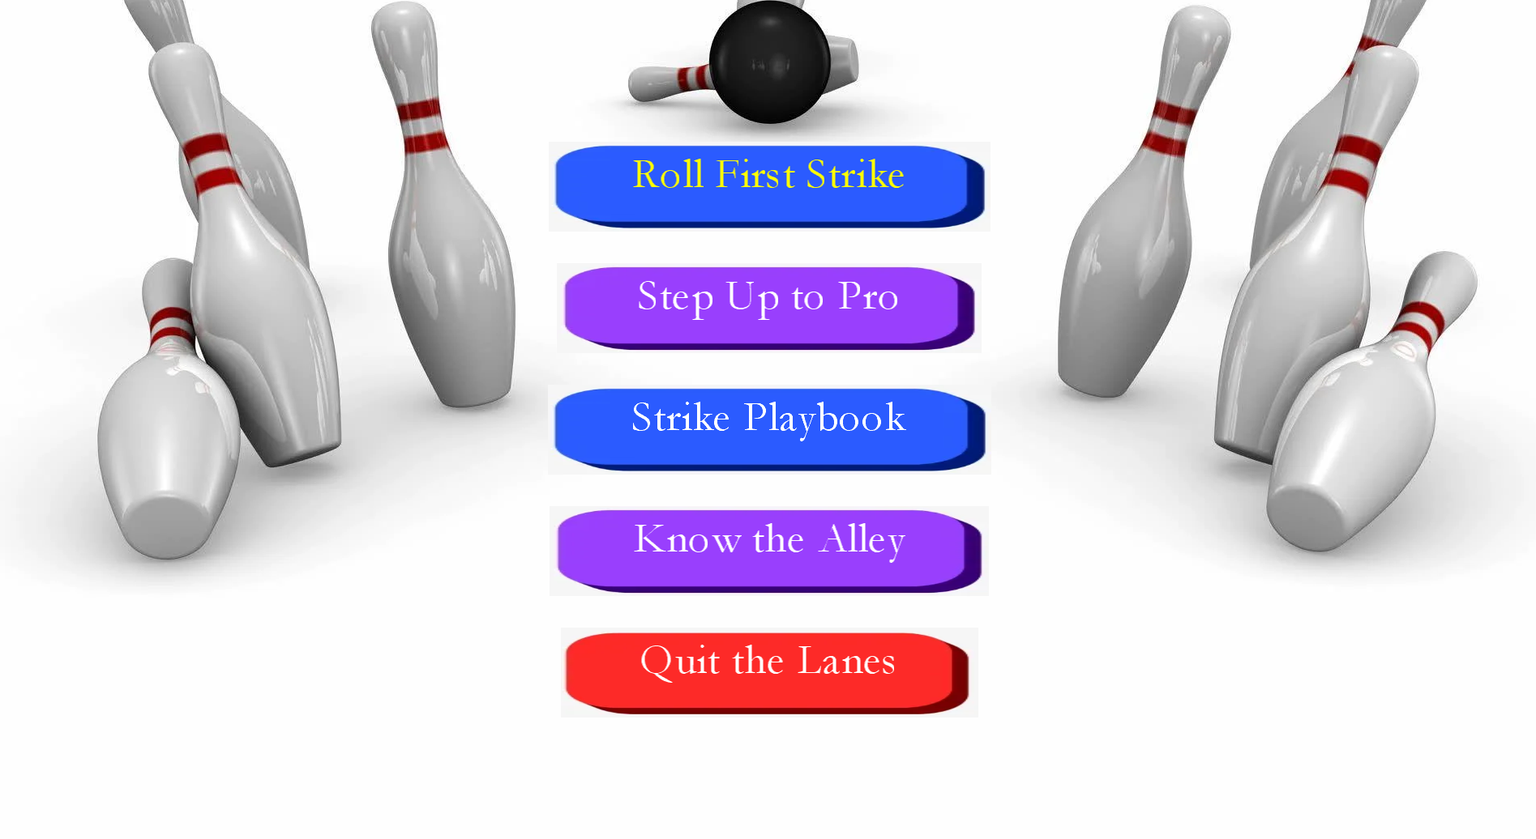
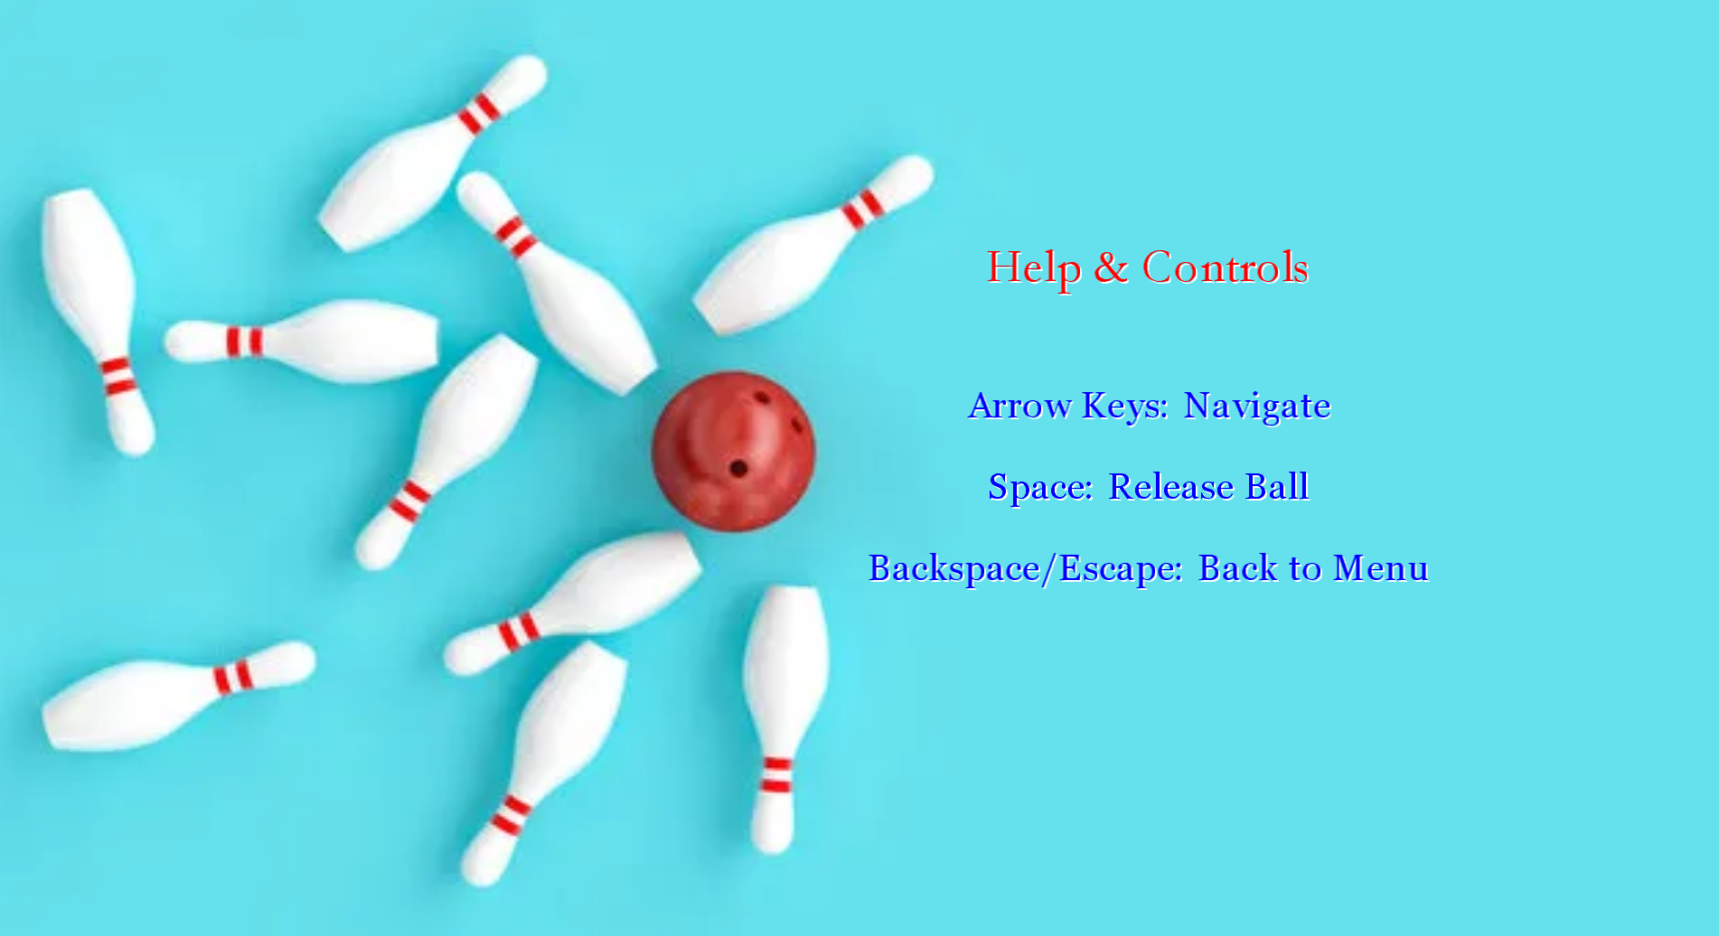
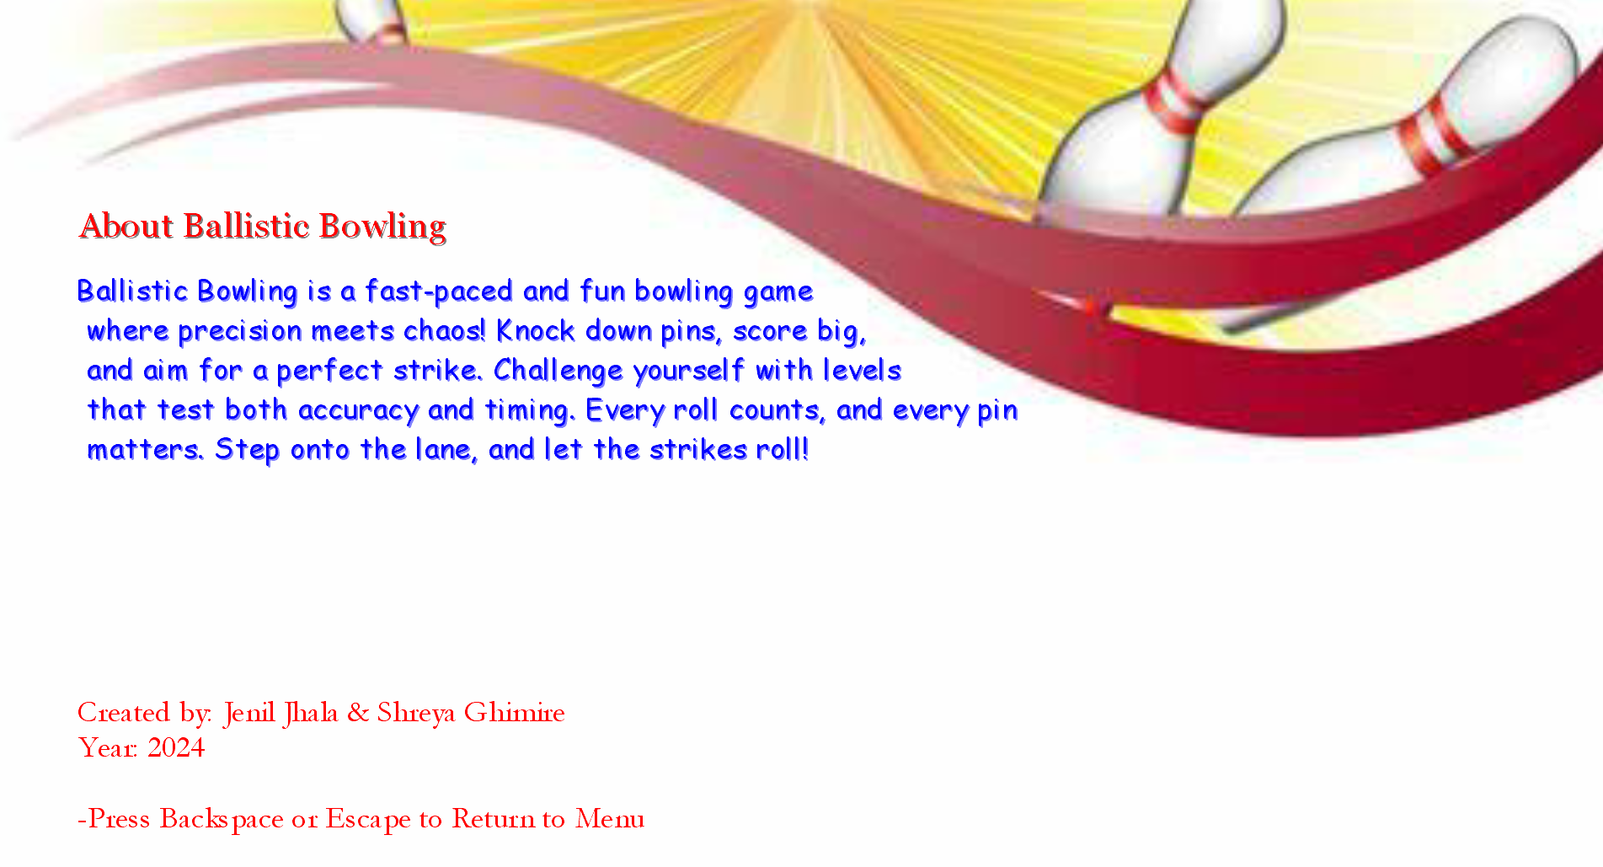
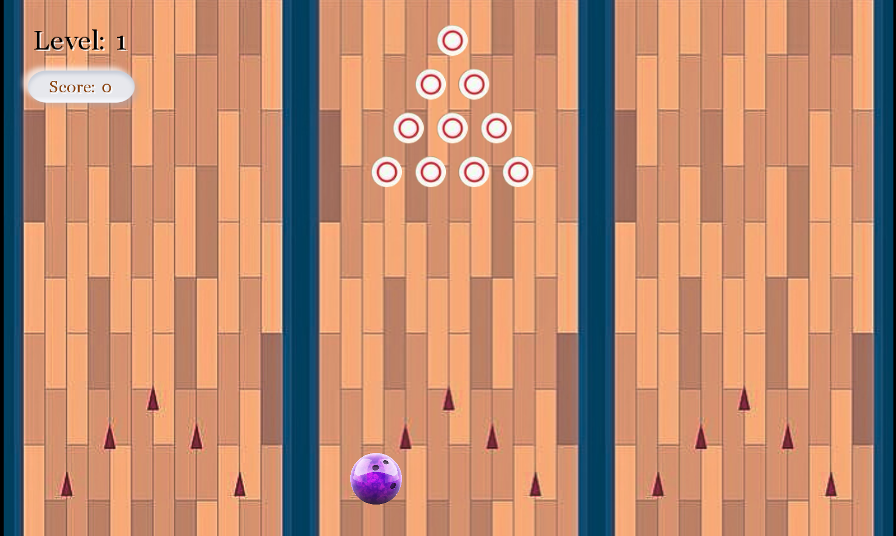
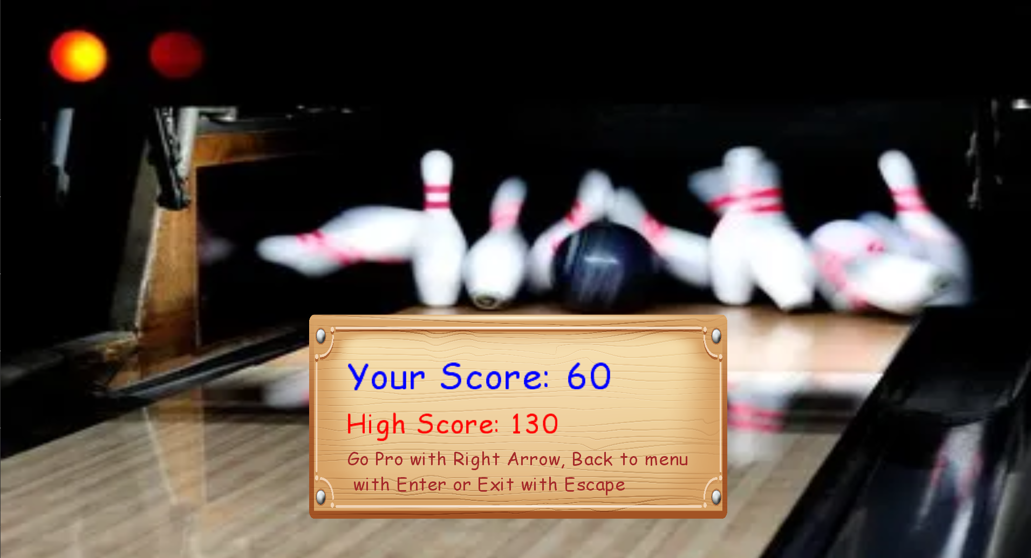
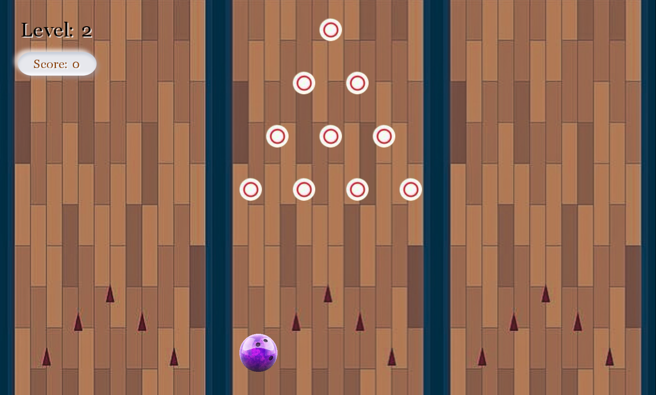
Appendix
Fig1: Menu Screen
Fig2: Help Screen
Fig3: About Screen
Fig4: Level 1 Screen
Fig5: Score Screen
Fig6: Level 2 Screen

Slide 13
